Slide 1
Building daily CalLite model from scratch – daily version

Slide 2
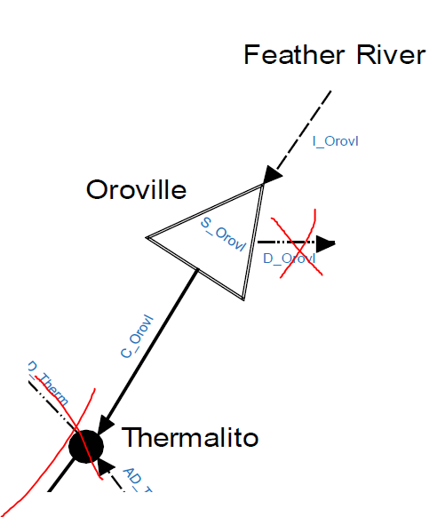
Phase 1
Develop very simple model
Inflow to Oroville reservoir
Oroville reservoir storage
Release from Oroville storage
Time period
October 2018-September 2019 (WY 2019)
Output
Daily Oroville releases

Slide 3
P1 data requirements
Daily Lake Oroville inflow (TAF/day)
Initial Lake Oroville storage

